Slide 1
Employee Performance Analysis Project Summary George Maina

Slide 2
Introduction
INX Future Inc Employee Performance
.
Following the company's employee performance indexes declining and client satisfaction levels coming down by 8% points, the objective was to initiate a data science project to analyze the employee data and find the core issues affecting the performance to help take the right actions without affecting other employee morals and overall company success.

Slide 3
1.Data Description and Exploration
Dataset from INX Future Employee Performance dataset

Slide 4
The dataset comprised various attributes related to employees including age, education level, job satisfaction, employee department, work-life balance and performance ratings. These variables were chosen to explore their impact on employee performance.
The data had 1200 rows with 28 variables which were clean. The variables were grouped into categorical and non_categorical for easier handling and interpretation of the data.

Slide 5



2.Data visualization
Insights from the employee performance department wise.

Slide 6
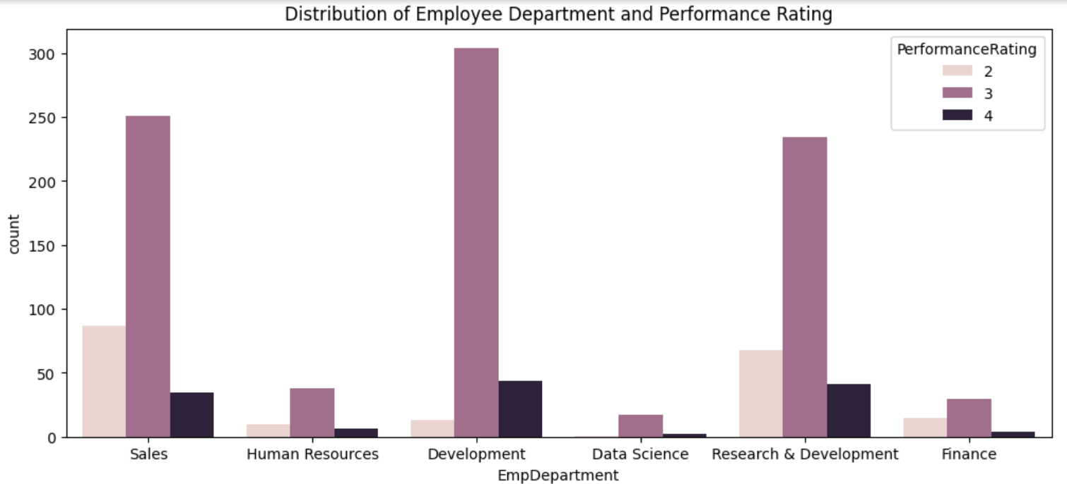
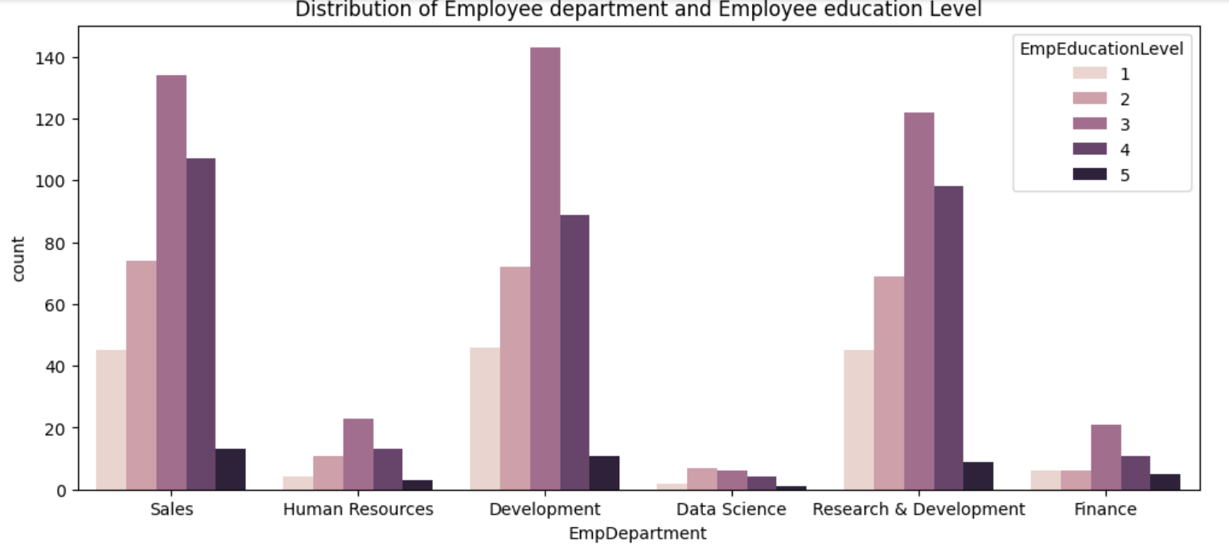
In all departments most employees have excellent performance (3).
Number of good performance (2) is greater than outstanding performance (4) in most departments.
Most average performance comes from Sales and Research & Development department and might be reason of declining performance in the company.
All departments had employees from bachelor (3) and master (4) level of education apart from Data science department which most employees were college level.
The high number of employees in college (2) and below college (1) level especially in sales and research & Development department suggests that they contribute to declining performance levels.

Slide 7
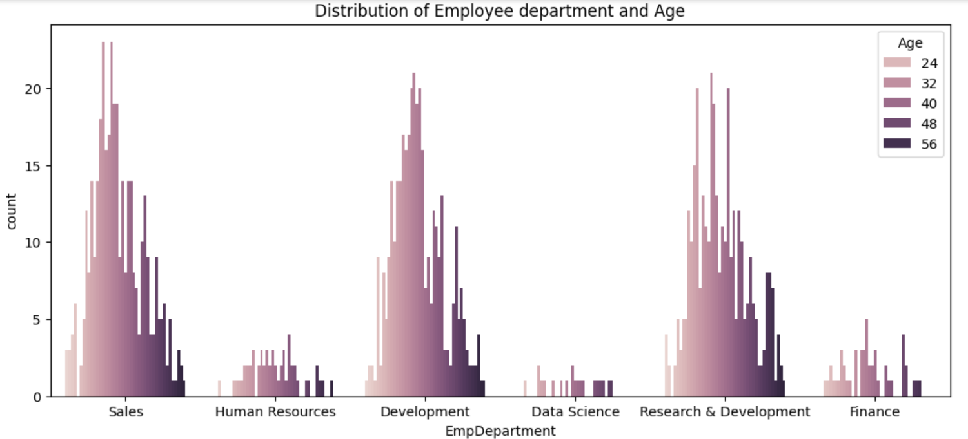
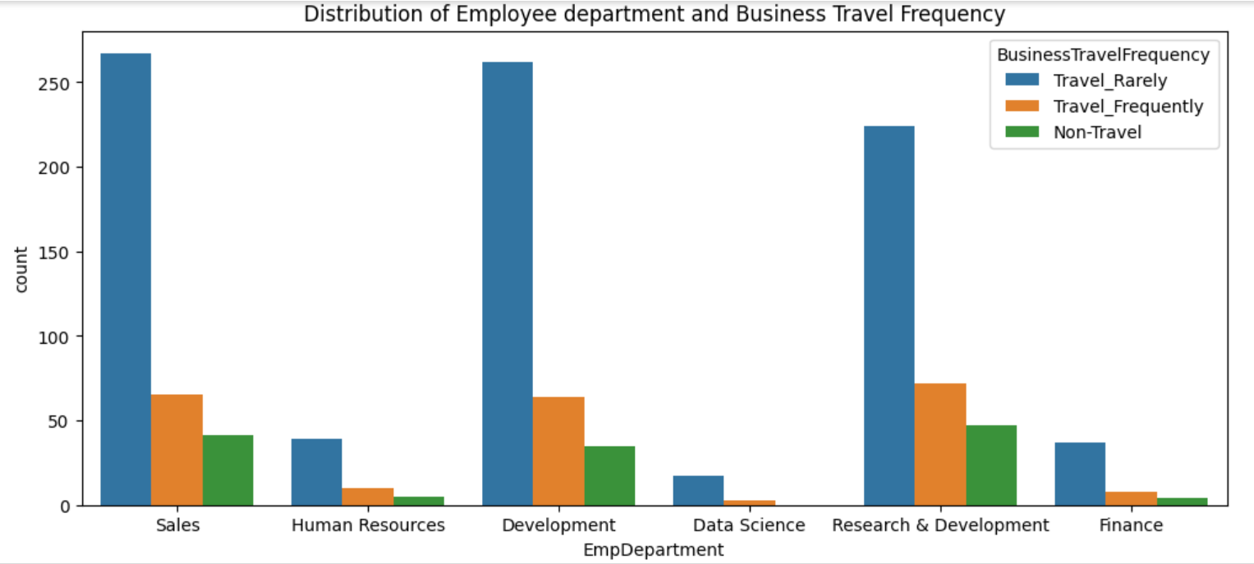
In most departments employees are concentrated between the age of 24 and 32. The age reduces as the number of employees decrease.
Data Science department has no significant distribution of age and the highest being between 24 and 40.
It is common that employees in all departments travel rarely.
Rewarding the employees with more business travels may motivate them and increase level of performance

Slide 8
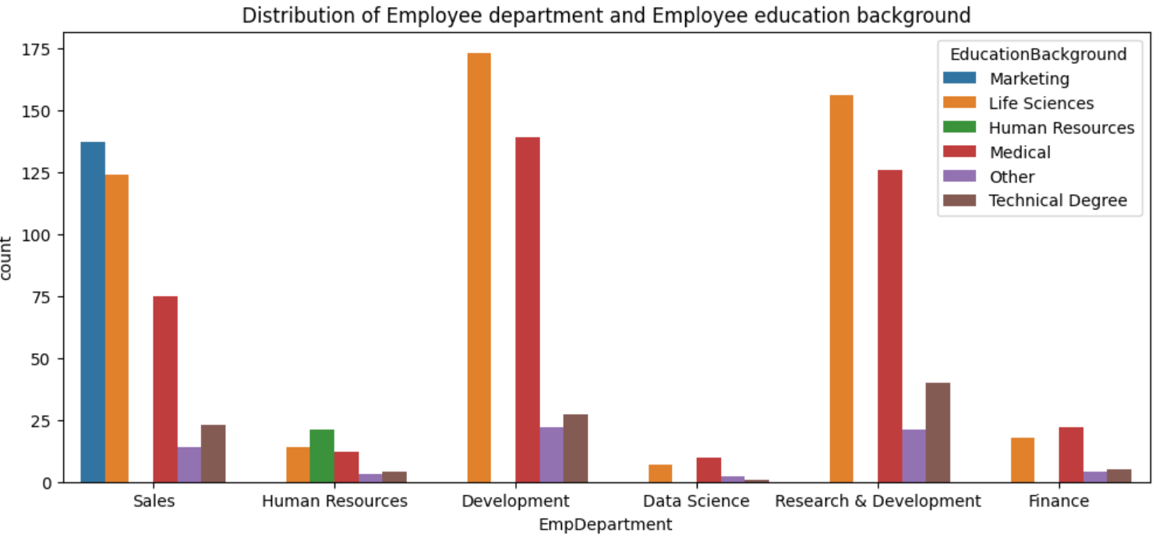
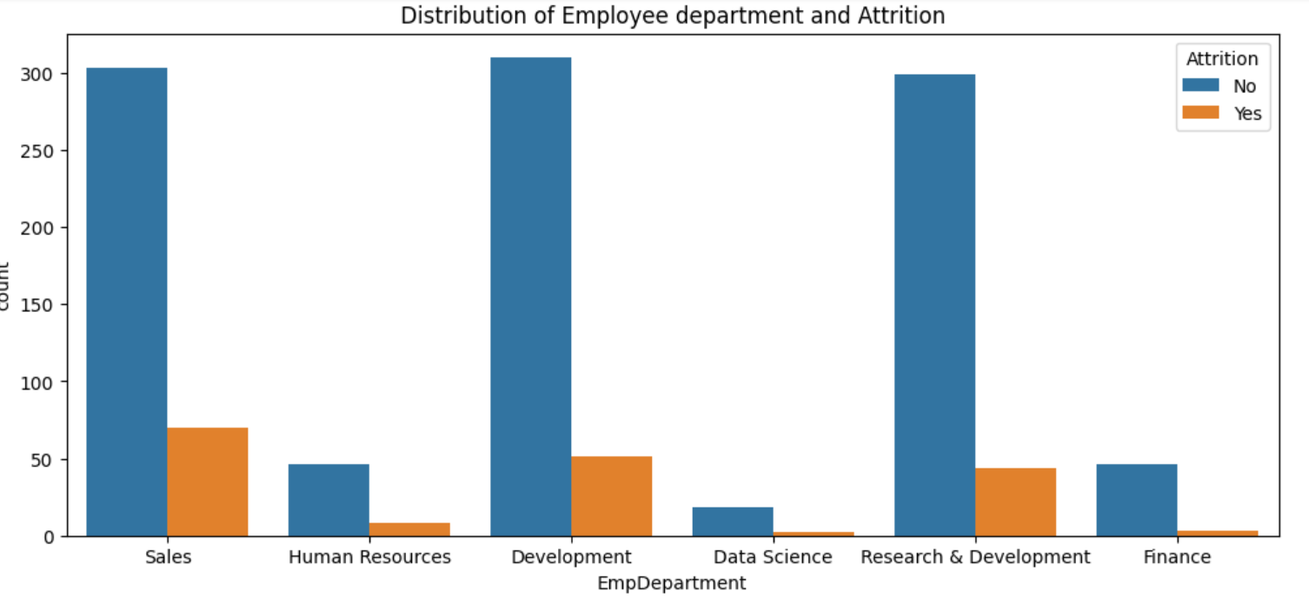
Sales department has most employees who studied marketing but still had a high number of employees who studied life science and medical which are not related.
Finance department has most of employees in medical education background instead of marketing and might result to poor performance.
The mismatch of role to education background might cause poor performance.
There is a high number of employees with no attritions.
Employees in Sales , Development and Research & Development departments have recorded over 50 attritions from their roles.
The employees who have attritions may lower the morale employees leading to poor performance.

Slide 9
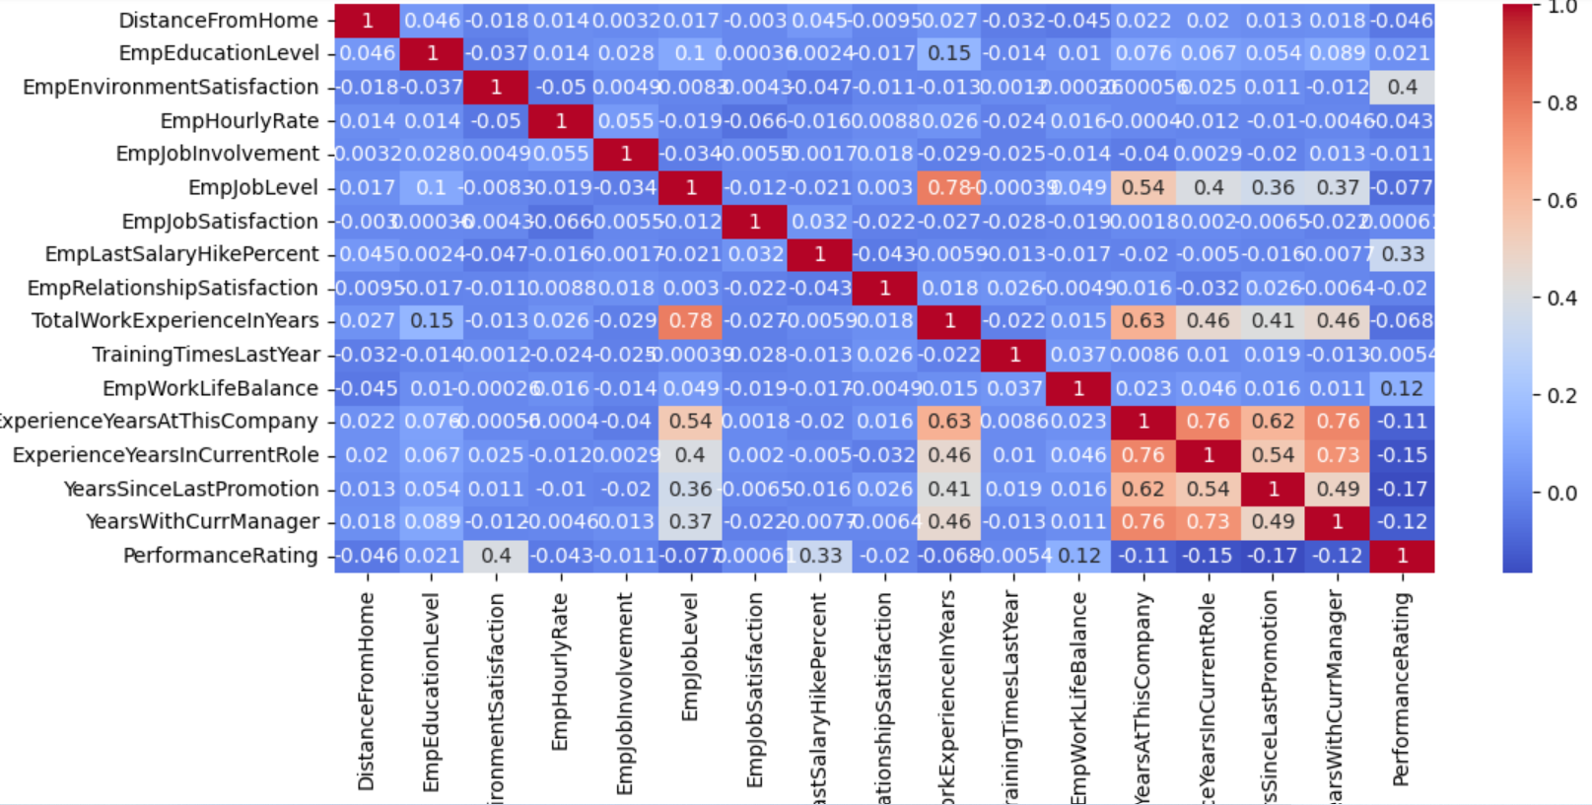
Correlation Heatmap
The employees years of experience at the INX company strongly relates with years of experience in current role (0.76), years with the current manager(0.76), years of total work experience (0.63), years since last promotion (0.62) and the employee job level (0.54).
According to the employee performance rating, there is no significant correlation with other factors directly but the employee environment satisfaction seems to have a positive but weak correlation (0.4), the employee last salary hike percent by (0.33) and the employee work life balance (0.12).

Slide 10
Key Features and Factors
From the analysis, main factors affecting the performance rating were:
Employee environment satisfaction
Employee last salary hike percent
Employee work life balance
Adding these feature variables to our machine learning will enable get an accurate and well performing model for the company.

Slide 11






3.Machine Learning
Libraries:
Sklearn.model selection
Sklearn.ensemble
Sklearn.metrics

Slide 12
Performance Rating Target Variable
By encoding my key feature variables:
EmpDepartment
EmpJobRole
BusinessTravelFrequency
EducationBackground
The target variable was a categorical type of data so classification type of models had to be used. I incorporated Random Forest Classifier, Decision Trees Classifier, SVM and KNN models to find my predictive analysis.
Skills like hypertuning helped in improving my models performance and Random Forest Classifier was Outstanding.
Random Forest Classifier had the best accuracy performance of 95% making it the best fit model for prediction.

Slide 13
4. Conclusion
From the results of our model having a very good accuracy, we can conclude that :
Employee environment satisfaction, salary hike percentage, and work-life balance emerge as the most significant factors directly linked to performance.
Sales, R&D, and Development departments exhibit lower performance rates and higher attrition, potentially due to mismatched educational backgrounds and a high proportion of inexperienced employees.
RECOMMENDATION
Consider linking salary hikes and promotions more directly to individual performance metrics.
Implement department-specific training programs to bridge skill gaps, particularly for employees with non-relevant educational backgrounds.

Slide 14
THANK YOU!

